Slide 1
Final Capstone
Presentation
Rhea Nair, Samiksha Sarda, Sana Sawant, Vedika Khandelwal
MGT 5905 - Business Analytics Capstone
Spring 2025
Notes:
Good evening, everyone.
Today, we are going to present our final capstone project.
I’m Sana, and I’m joined by my teammates Rhea, Samiksha, and Vedika.
We’ve been working on uncovering customer behavior insights using transaction data from an online wholesale retailer.
To begin, let’s walk through the business understanding and the core objective guiding our analysis.

Slide 2
Business Understanding
Our goal is to build a comprehensive customer intelligence study that not only describes what is happening in the business, but diagnoses why it’s happening, prescribes what should be done next, and predicts what lies ahead.
Key strategic questions include:
What products should be sold to which countries, and during which time periods, to maximize sales?
How do customer behaviors vary by region, season and product type?
Which products are often purchased together, how can this support effective bundling strategies?
How can we better understand and serve different customer segments based on their value contribution?
Notes:
"Our project begins with a fundamental business challenge: how can we turn raw transactional data into real, actionable customer intelligence? The goal isn’t just to understand what’s happening in the business—but to dive deeper into why it’s happening, what we should do next, and even anticipate what lies ahead.
To guide our approach, we framed four key strategic questions: First, what products should be sold to which countries and at what time to maximize sales? Second, how does customer behavior vary across regions, product types, and seasons? Third, which products are frequently purchased together—and how can that inform better bundling strategies? And finally, how can we segment customers based on their value to the business and tailor our strategies accordingly?
These questions formed the foundation of our analytics approach and drove the structure of the rest of our project."

Slide 3
Data Cleaning and Preprocessing
This Online Retail II data set contains comprises of 1,033,036 transactions occurring for a UK-based and registered, non-store online retail between Dec’09 and Dec’11. The company mainly sells unique all-occasion giftware to wholesalers.
Challenges of the dataset included missing values in Customer ID and product descriptions, illegible product descriptions (“missing”), non-Product ID codes, negative quantity and prices.
We removed rows with Illegible Product Descriptions for e.g., “????”, “?damage??”, “missing”, non-product Stock Codes for eg,B (bad debt), C (canceled) and negative or zero Quantity/Price
We then created a new variable, Sales = Quantity × UnitPrice, and filtered for positive-value transactions to focus on valid purchases
Notes:
"This dataset comes from the Online Retail II collection, containing over one million transactions from a UK-based non-store retailer that sells giftware to wholesale buyers. The timeframe spans from December 2009 to December 2011.
Before diving into analysis, we had to address several data quality challenges. These included missing values in critical columns like Customer ID and Product Description, illogical entries like '????' or '?damage??', and non-product stock codes such as 'B' for bad debt or 'C' for canceled orders. We also removed rows with zero or negative values for quantity or price, as these likely represented returns or system errors.
After cleaning, we created a new variable called ‘Sales,’ calculated as Quantity multiplied by Unit Price, and filtered the dataset to include only positive-value transactions. This gave us a much cleaner, more reliable dataset to work with for our downstream analyses."

Slide 4
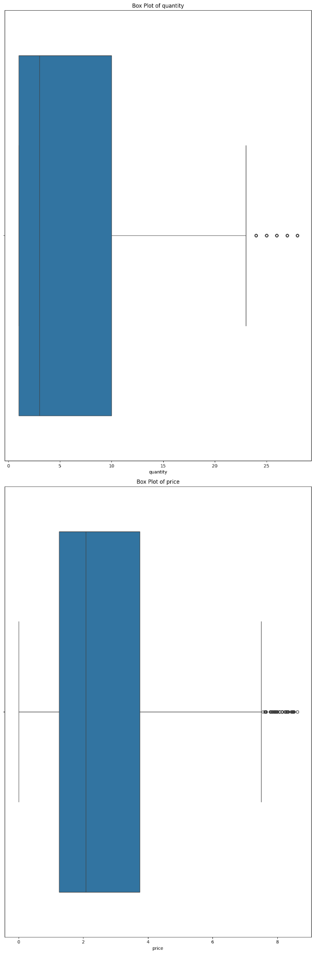
Exploratory Data Analysis
Outliers removed: 140,870
Notes:
Here, we conducted exploratory analysis using box plots to examine the distribution of Quantity and Price — after removing outliers.
Initially, both fields showed heavy skewness and extreme values. After removing the outliers, we noticed more stable and interpretable distributions. This step was critical to ensure that downstream analysis, like customer value modeling, wouldn’t be distorted by anomalous entries.
This foundational cleaning allows us to generate more meaningful visualizations and business insights — which we’ll showcase in the next slide.

Slide 5
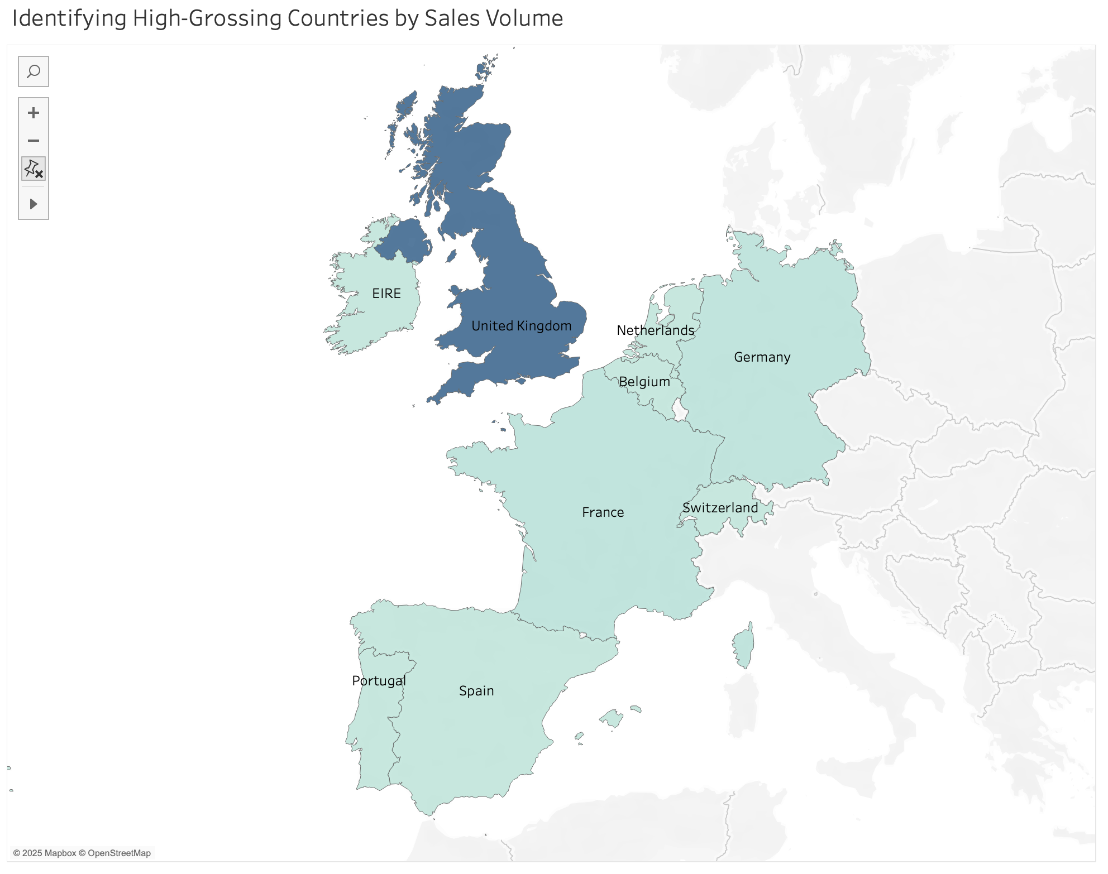
Notes:
"This map visualization shows total sales volume by country, helping us identify the markets that contribute most to overall revenue. As you can see, the United Kingdom stands out as the top-performing region by a significant margin. This aligns with the company’s base location and likely reflects greater brand awareness and logistical reach within the UK.
Countries like Germany, France, and EIRE (Ireland) also show relatively strong sales, while smaller but promising markets such as the Netherlands and Switzerland present opportunities for growth. This country-level breakdown helped guide our decision to conduct more targeted analyses—such as segmenting customers and building region-specific bundling and timing strategies later in the project."

Slide 6
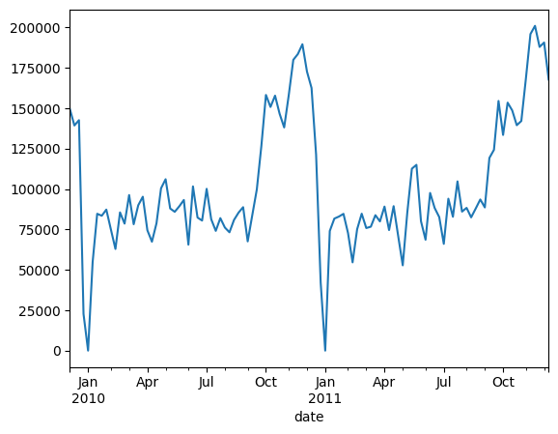
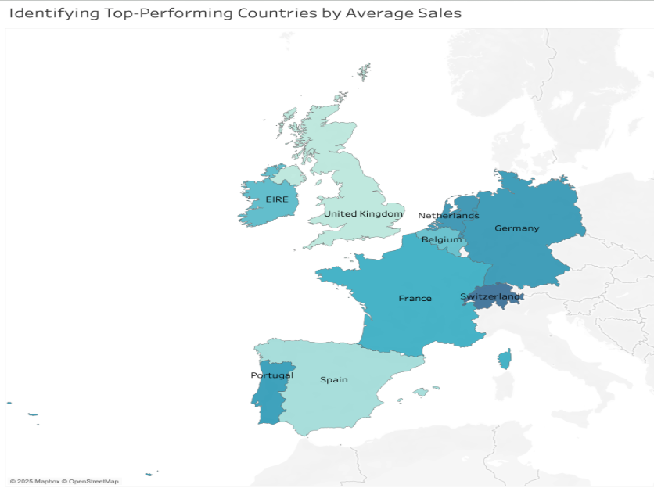
Data Analysis & Strategy, Understanding the Why?
Avg Daily Sales by Month
Avg Sales by Country
Notes:
"This slide bridges our descriptive analysis with the strategic insights that guided our modeling decisions.
On the left, the line chart shows average daily sales by week. We observed several seasonal peaks—most notably around November and December, indicating strong year-end demand, likely driven by holiday sales. These spikes informed our decision to factor seasonality into our forecasting model later in the project.
On the right, the map shows average sales by country. Germany, Switzerland, and the Portugal stand out as top performers in terms of average transaction value. Interestingly, although the UK had the highest overall volume, countries like Switzerland had fewer but higher-value purchases. This suggested differences in buyer behavior across regions and led us to segment markets accordingly in the RFM and Apriori phases of our analysis."

Slide 7
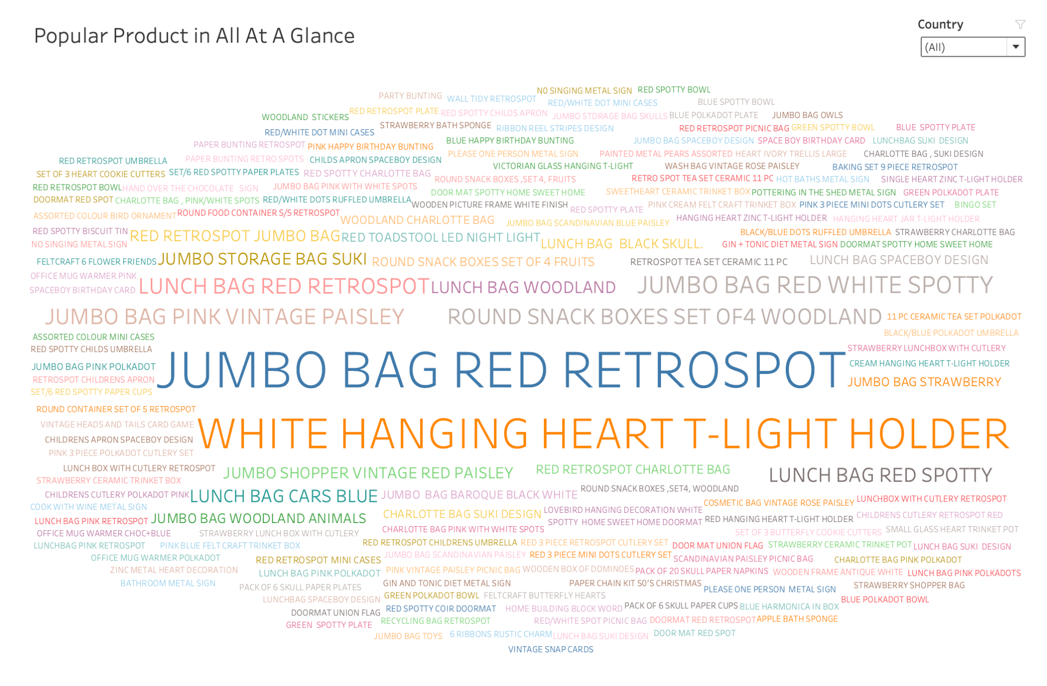
Notes:
"This word cloud gives us a quick visual overview of the most frequently purchased products across all countries. The size of each product name corresponds to how often it appears in the dataset—larger items indicate higher purchase volume.
As we can see, products like 'JUMBO BAG RED RETROSPOT' and 'WHITE HANGING HEART T-LIGHT HOLDER' dominate the visualization, suggesting they are some of the top-performing SKUs. These are likely high-appeal items that can be considered for bundling, featured promotions, or inventory prioritization.

Slide 8
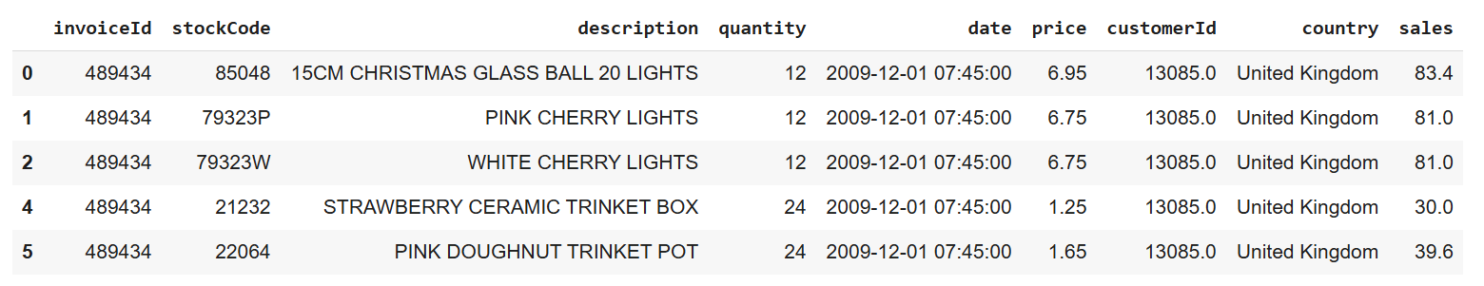
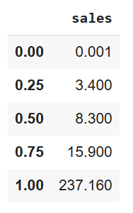
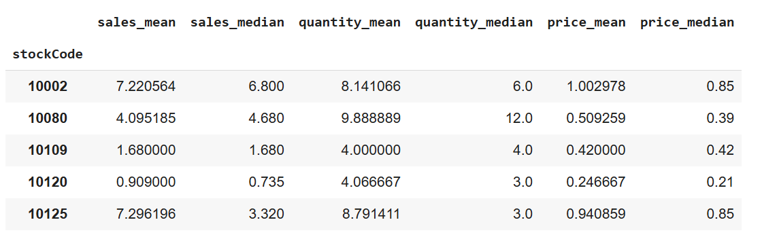
Descriptive Statistics
Item-level analysis data
Quartile for sales
Descriptive statistics for sales
Notes:
This slide gives a quick overview of our dataset. It includes around 40,000 invoices, 5,800 customers, and product-level data across 43 countries. We analyzed 5,400 product descriptions and nearly 5,000 stock IDs. To understand sales behavior, we calculated quartiles—50% of sales are below unit price of £8.30 pounds , but the top 25% exceed the unit price of £15.90, with the highest sale over £237. We also aggregated stats per product; for instance, item 10002 averages £7.22 in sales and about 8 units sold. This helped us spot trends and outliers for deeper analysis.

Slide 9
Customer Categorization- Recency Frequency and Monetary Analysis
RFM Analysis is a customer value based segmentation technique used in marketing and analytics. It categorizes customers based on their purchasing behavior using three key factors- Recency, Frequency and Monetary.
We chose RFM because it is well-suited for transactional retail data, requires minimal assumptions, and provides intuitive, actionable results for marketing teams. The diagnostic nature of RFM allowed us to pinpoint both strengths (loyal buyers) and opportunities (lapsed or newly acquired customers) at a very granular level, helping inform who to target.
Notes:
"To better understand customer behavior, we used RFM analysis—Recency, Frequency, and Monetary value. It’s a well-established technique in marketing and analytics that segments customers based on how recently they purchased, how often they purchase, and how much they spend.
We chose RFM because it’s lightweight, doesn’t require many assumptions, and delivers clear, actionable insights. It allowed us to pinpoint loyal, high-value customers as well as identify segments that need re-engagement—like those who haven't purchased in a while or who only bought once.
This segmentation was essential for guiding our bundling and marketing strategies by helping us understand exactly who to target and how to prioritize our efforts."

Slide 10
Business Insights From RFM
In the UK, we identified a high-engagement customer base characterized by frequent and recent purchases, but with a lower average order value. This suggests a loyal customer segment with potential to increase basket size through cross-sell or volume incentives.
In Ireland and the Netherlands, purchasing behavior was consistent, but transaction value remained low. This indicates an opportunity to drive revenue growth through strategic bundling or targeted upselling campaigns.
In Switzerland, we observed a wave of growing potential loyalists exhibiting recent but infrequent purchase activity. This signals an early-stage engagement window that can be leveraged through onboarding journeys and retention-focused offers.
The RFM segmentation uncovered both high-performing customer cohorts and untapped growth segments, enabling a data-driven foundation for precision marketing, reactivation efforts, and segment-specific campaign planning.
Notes:
"Here are some of the key business insights we uncovered from our RFM analysis:
In the UK, we identified a loyal and highly active customer base — they purchase frequently and recently, but their average order values are low. This presents a strong opportunity to increase basket size through bundling or volume-based promotions.
In Ireland and the Netherlands, customers were consistent buyers, but the overall spend per transaction remained low. This indicates a need for strategic upselling, perhaps through curated product bundles to increase average order value.
Switzerland stood out for having a large number of newly acquired customers who purchased recently but not often. This signals an early engagement window where retention-focused campaigns could help build loyalty.
Overall, the RFM analysis helped us identify both high-performing and underutilized customer groups. This gives the business a data-backed foundation for precision targeting, reactivation campaigns, and segment-specific planning."

Slide 11
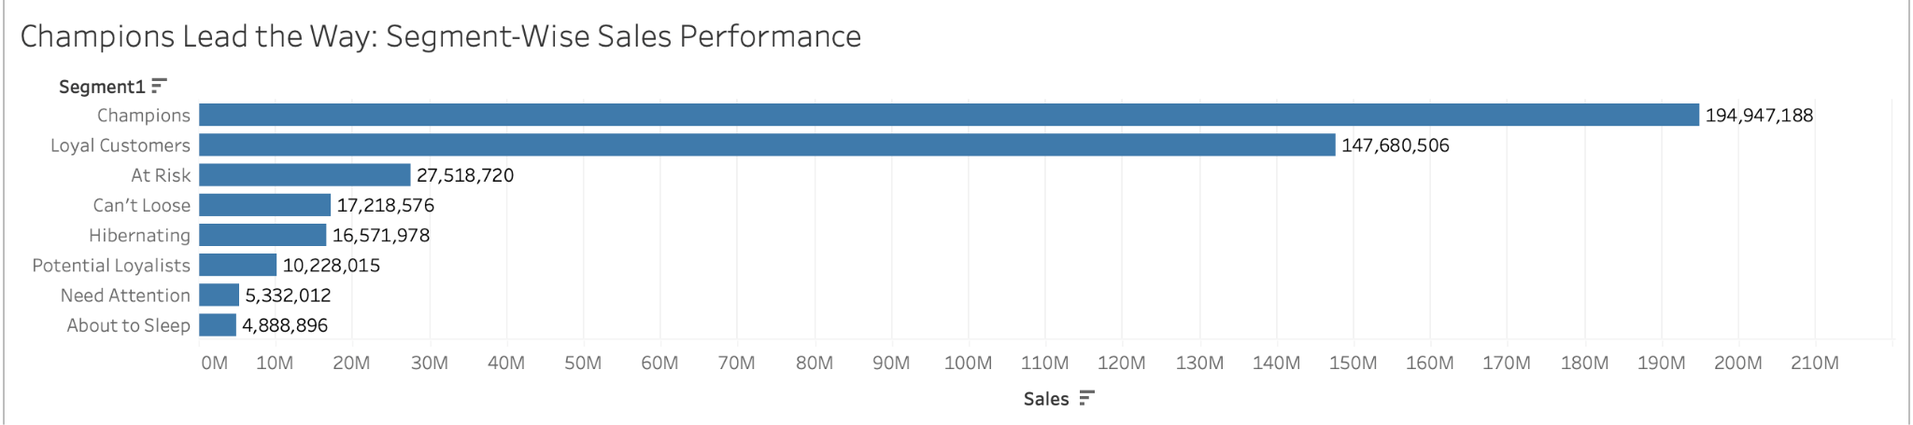
Notes:
"This bar chart breaks down total sales by customer segment based on our RFM analysis.
The 'Champions' and 'Loyal Customers' segments drive the majority of revenue — with Champions alone contributing nearly £195 million in sales. These are our most valuable customers: they purchase often, spend more, and buy recently.
However, the 'At Risk' group still contributes over £27 million in sales, which shows strong potential for reactivation if we engage them strategically.
The 'Can't Lose' and 'Hibernating' segments, while smaller, also present opportunities for personalized campaigns. On the lower end, we see 'Need Attention' and 'About to Sleep' — segments that may require more effort or might not yield high returns.
This breakdown helps us prioritize which groups to invest in for retention, reactivation, or growth."

Slide 12
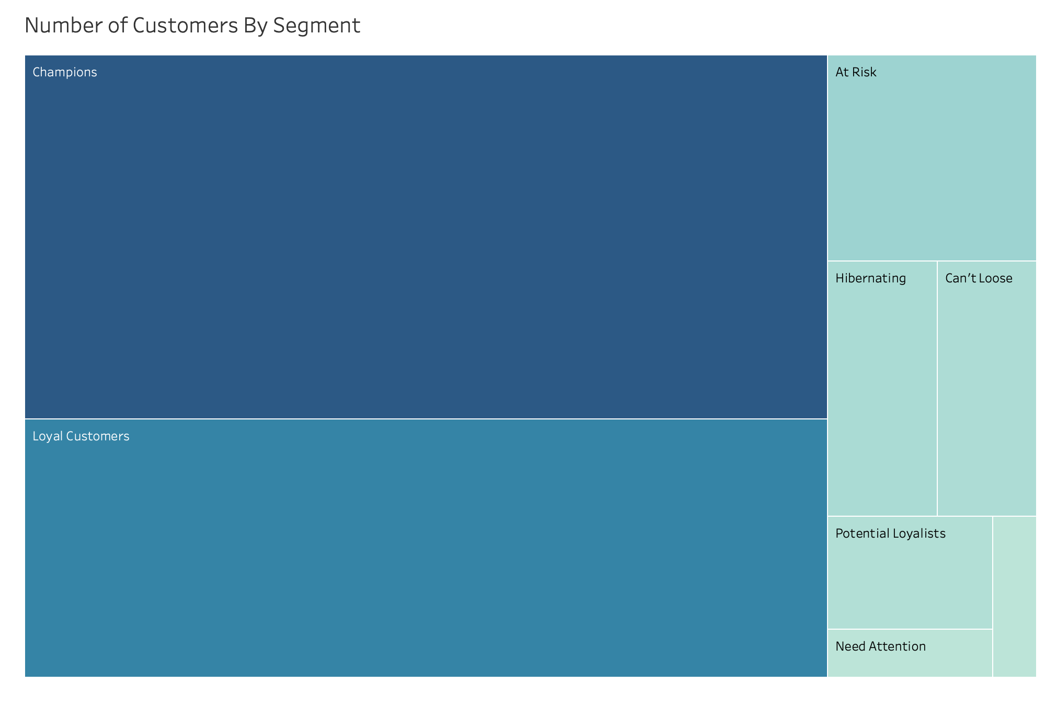
Notes:
"This treemap shows the output of our RFM analysis, where we segmented customers into different behavioral groups based on their recency, frequency, and monetary scores.
Each box represents a customer segment, and its size corresponds to the number of customers in that group. As shown, 'Champions' and 'Loyal Customers' make up the largest portions of the customer base. These are our most engaged and valuable segments and should be prioritized for retention and upselling efforts.
On the other hand, smaller segments like 'Need Attention,' 'Hibernating,' and 'About to Sleep' reflect customers with low recent engagement. These groups may require reactivation strategies or nurturing campaigns.
This visualization helped us clearly see where the bulk of our customer base lies and how we can tailor targeted actions to each segment’s behavior and value."

Slide 13
Product Bundling- Apriori Market Basket
The Apriori algorithm is used for association rule mining that identifies frequent itemsets and association rules in a dataset, particularly useful for applications like market basket analysis.
It identifies which items are frequently bought together by analyzing transactions using three key concepts- Support (How often items appear together), Confidence (How often item B appears after item A) and Lift – How likely is the bundle an association and not a coincidence.
We opted for Apriori due to its interpretability, wide adoption in retail analytics, and ability to surface meaningful product affinities across thousands of SKUs. It highlights the cultural depth of buyer preferences and the prescriptive recommendations are especially valuable when linked back to RFM segments, allowing us to suggest the right bundle for the right customer.
Notes:
"To understand what customers tend to buy together, we used the Apriori algorithm for market basket analysis. This algorithm helps us find frequent itemsets and association rules—basically identifying which products are commonly bought in the same transaction.
It works using three key metrics:
Support, which shows how often items appear together,
Confidence, which tells us how often item B is purchased when item A is, and
Lift, which tells us whether that relationship is meaningful or just coincidental.
We chose Apriori because it’s widely used in retail analytics, is easy to interpret, and it handles large volumes of product data well. It helped us uncover culturally relevant buying patterns—like decorative bundles being popular in the UK or more practical household items being bundled in France. When we combine these findings with RFM segments, we can suggest the right bundles to the right customers, at the right time."

Slide 14
Business Insights
In the UK, customers frequently purchased decorative and gift items such as t-light holders, patterned lunch bags, and novelty storage bags. However, these were often bought individually, not as sets. This reflects a high engagement, low basket value pattern. Given this behavior, there’s a strong opportunity to introduce thematic bundles or multi-buy offers to increase average order value without disrupting existing buying habits.
In France and Germany, purchasing patterns leaned toward practical home goods—including night lights, snack boxes, and utility tins—often bought in sets of 4 or 6. This indicates a value-conscious, utility-driven customer base, where promoting multi-unit packs or function-based kits could enhance perceived value and margin.
By combining Apriori associations with RFM segmentation, we crafted bundling strategies that matched both product affinity and customer value tier. This allowed us to deploy geography-specific, segment-personalized product recommendations—increasing the likelihood of conversion, basket lift, and long-term retention.
Notes:
"Our market basket analysis revealed strong regional patterns in product preferences.
In the UK, customers frequently purchase decorative and gift-oriented products like t-light holders, patterned lunch bags, and novelty storage bags. However, these are typically bought individually. This signals a high engagement but low basket value behavior—suggesting an opportunity to introduce themed bundles or volume-based discounts to lift average order value without changing existing habits.
In contrast, customers in France and Germany tend to purchase more practical, utility-driven items—like night lights and snack boxes—in sets of 4 or 6. This reflects a value-conscious mindset. Bundling here can focus on function-based or multi-pack kits to drive margin.
By combining Apriori results with RFM segmentation, we were able to tailor bundle strategies based on both product affinity and customer value. This approach allows for more personalized, geography-aware product recommendations, increasing chances of conversion, boosting revenue, and supporting long-term customer retention."

Slide 15
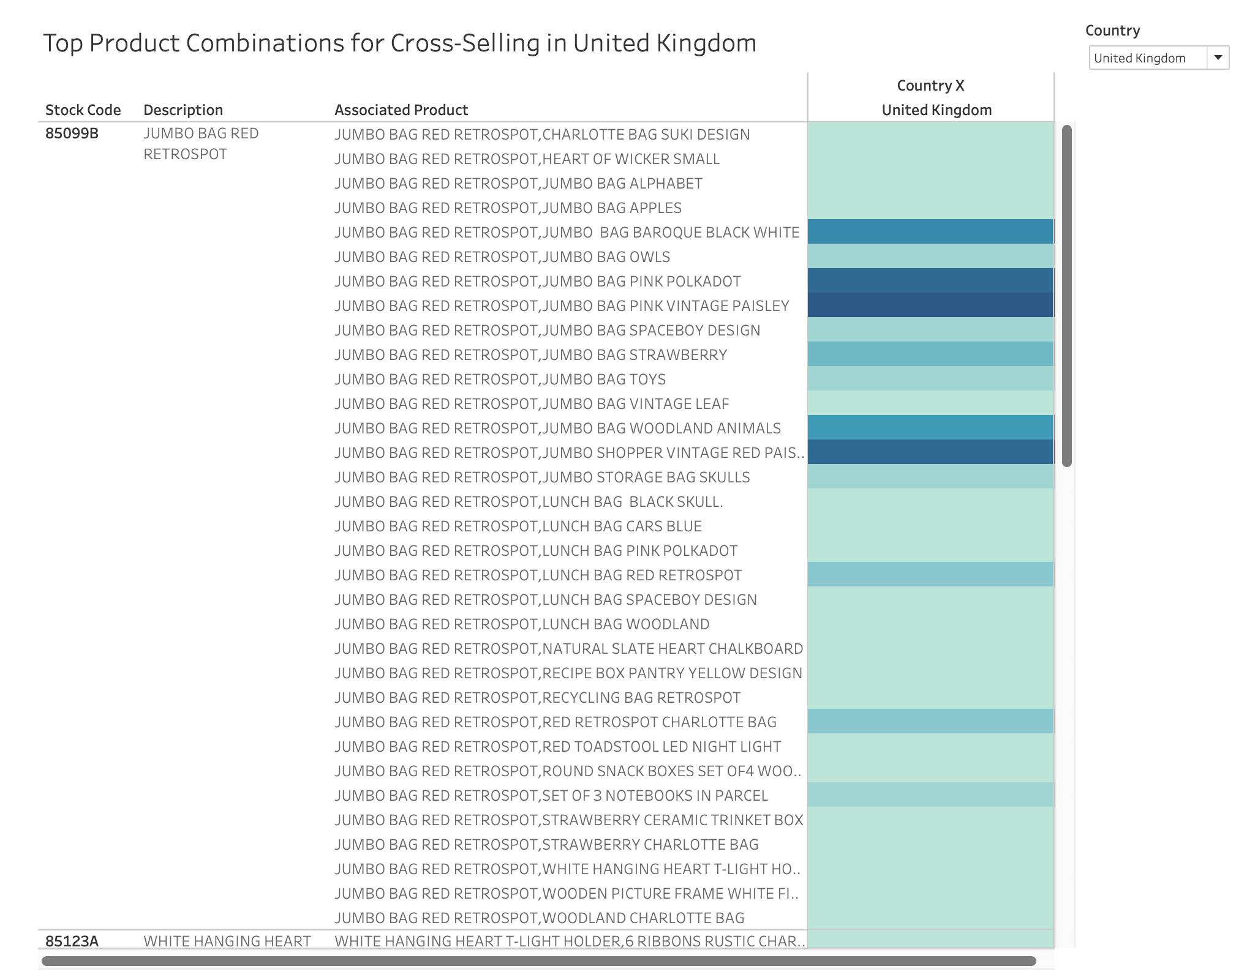
Notes:
"This heatmap shows the output of our Apriori market basket analysis specifically for the United Kingdom.
The base product here is the 'JUMBO BAG RED RETROSPOT,' which emerged as one of the most frequently purchased items. The table lists the top associated products that are often bought together with it. These include a variety of other jumbo bags, lunch bags, and gift items like the 'CHARLOTTE BAG SUKI DESIGN' and 'HEART OF WICKER SMALL.'
The color intensity on the right reflects the strength of association in terms of sales volume — darker shades indicate higher sales when the associated product is purchased alongside the base item.
This analysis helps us uncover strong product affinities within the UK market and supports strategic bundling or cross-sell opportunities, especially during promotional campaigns or seasonal sales."

Slide 16
Holt-Winters Analysis
Holt-Winters Analysis is a time series forecasting technique used in business and analytics. It predicts future values based on past sales trends, seasonal patterns, and overall growth or decline in the data. It uses three key components- Level, Trend, Seasonality.
Prior to modeling, we aggregated sales at a monthly level by product and country, filtered out series with fewer than 24 months of data, and resampled to ensure consistency.
We selected Holt-Winters because it handles seasonal cycles effectively, is computationally lightweight for thousands of product-country combinations, and does not require external features, making it ideal for SKU-level demand forecasting in an e-retail setting.
Notes:
In this part of our analysis, we used Holt-Winters Exponential Smoothing as a predictive tool to forecast future sales trends. This method is particularly suited for retail analytics because it captures seasonal patterns, overall trends, and baseline levels within time series data. It's especially useful when you're trying to determine when to market specific products and plan promotions.
Before we applied the model, we aggregated sales monthly by product and country, filtered out any time series with fewer than 24 months of data, and resampled for consistency. We selected Holt-Winters because it’s computationally efficient, doesn’t require external variables, and scales well across thousands of SKU-country combinations—making it perfect for a large, dynamic e-retail dataset.
The forecasts revealed meaningful patterns: for example, demand in the UK and Germany peaks in November, likely due to holiday gift purchases, while Spain experiences dips in the summer months. We also saw strong seasonal rhythms in smaller markets like the Netherlands and Australia, and signs of growth in emerging product categories, pointing to early-stage adoption.
Overall, this predictive layer doesn’t just tell us what might happen—it guides when to act, helping inform everything from inventory planning and campaign timing to product bundling and market expansion strategies.

Slide 17
Business Insights
In the UK and Germany, demand consistently peaked in November, particularly for gifting and decorative products like festive t-light holders and holiday-themed bags. This underscores the importance of front-loading inventory and marketing spend in Q4 to capitalize on seasonal buying behavior.
In Spain, a predictable summer dip in sales suggests a need to scale back promotions or reallocate marketing resources during that period to maximize ROI.
Although smaller in volume, Netherlands and Australia demonstrated stable seasonal demand curves, highlighting them as candidates for localized campaigns and precision-driven inventory planning.
Additionally, early-stage growth trajectories in emerging markets for select SKUs point to new product-market fit opportunities and strategic expansion potential.
These insights allowed us to move from reactive sales planning to a proactive, demand-aligned strategy, ensuring that bundles, discounts, and advertising are deployed at the right time, in the right market, to the right segment.
Notes:
This slide highlights some of the most actionable insights we uncovered through Holt-Winters forecasting and geographic demand analysis.
Starting with the UK and Germany, we observed that demand consistently peaked in November, driven largely by gifting and decorative items like t-light holders and holiday-themed bags. This insight suggests the need to front-load inventory and marketing spend in Q4 to capitalize on holiday shopping behavior.
In contrast, Spain showed a predictable summer dip in sales. For this region, a smarter approach would be to reduce promotions or shift marketing efforts to months with stronger demand, helping maximize ROI.
Next, although Netherlands and Australia are smaller markets in terms of volume, they revealed stable and recurring seasonal patterns. This consistency makes them ideal candidates for localized marketing efforts and precise inventory control.
We also identified early signs of product growth in emerging regions—where certain SKUs are just beginning to pick up. These could represent new product-market fit opportunities or potential expansion strategies.
All of these findings enable a shift from reactive planning to a more proactive, demand-aligned sales strategy. It ensures that promotions, bundles, and discounts are launched at the right time, in the right market, and targeted to the right customer segment.

Slide 18
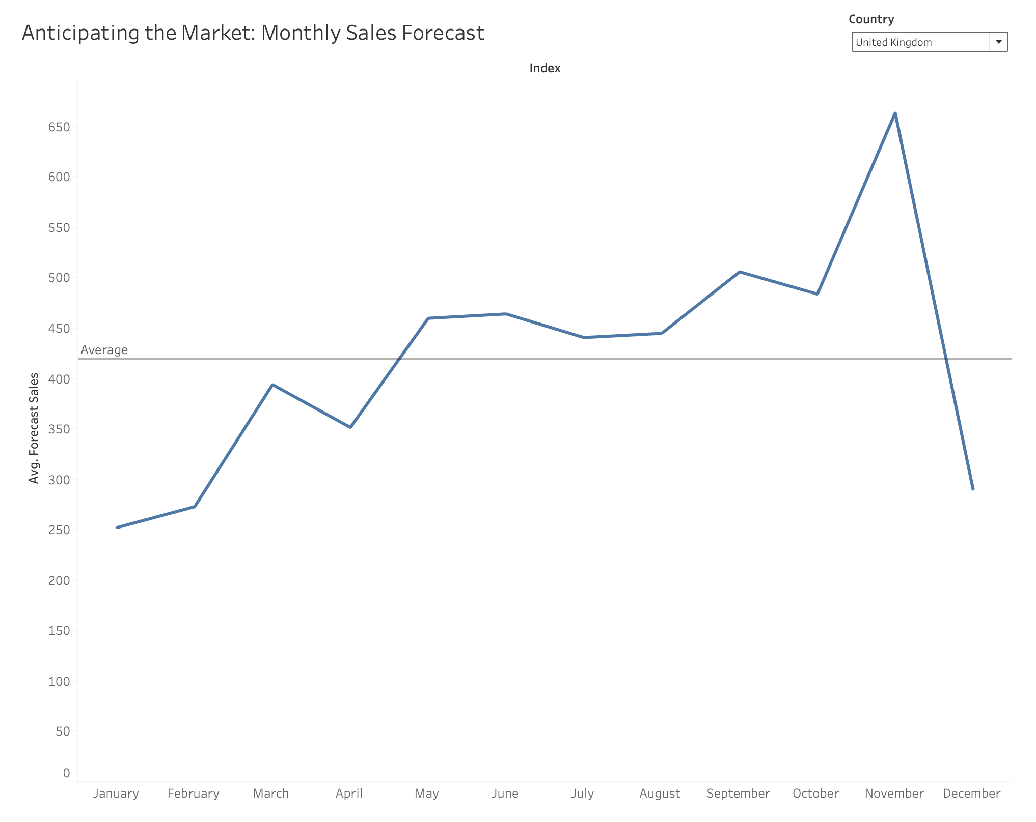
Notes:
This line chart shows the monthly forecasted sales for the United Kingdom, based on the Holt-Winters exponential smoothing model.
You can see the forecasted values plotted from January to December. The dotted line across the chart marks the average forecasted sales across all months, providing a helpful baseline for comparison.
One of the key insights here is the clear seasonality in the UK market. Sales steadily increase throughout the year, with a pronounced spike in November. This aligns with gifting and holiday demand, especially for products like t-light holders and holiday-themed bags that we observed earlier. This pattern underscores the importance of aligning marketing campaigns, inventory, and promotions with peak buying periods.
After the November peak, there’s a sharp drop in December, which likely reflects the post-holiday slowdown. Planning for this drop is equally important to avoid overstocking.
What this visualization enables us to do is predict and prepare. It helps the business proactively front-load inventory for Q4 and adjust resources in months with lower expected demand—ultimately supporting smarter decisions across marketing, logistics, and merchandising.

Slide 19
Smart Product Bundling: Matching the Right Products to the Right Customers at the Right Time
By combining RFM, Apriori, and Holt-Winters analyses, we turned raw data into a fully actionable customer strategy.
We mapped Apriori-identified product bundles to specific RFM customer segments, and then used Holt-Winters forecasts to time those bundles for maximum seasonal impact.
For example, a holiday-themed gift bundle was frequently purchased by high-frequency, moderate-value UK customers, with demand forecasted to peak in November making it ideal for a targeted Q4 campaign.
In Germany, summer bundles aligned with formerly high-value but inactive customers, creating a timely opportunity for reactivation during seasonal dips.
Notes:
This slide brings together the three core analyses we performed—RFM, Apriori, and Holt-Winters—into one integrated customer strategy. By combining these methods, we moved from just understanding what happened, to predicting what will happen and prescribing what should be done.
We began by using Apriori market basket analysis to identify product combinations frequently purchased together. Then, we mapped those bundles to specific customer segments created through RFM analysis—like “Champions,” “At Risk,” or “Hibernating” customers.
But we didn’t stop there—we used the Holt-Winters time series model to forecast when these bundles would be most in demand. This allowed us to time our campaigns for maximum seasonal and regional impact.
For example, we discovered that UK customers in the Loyal or Champion segments often buy holiday-themed products, especially in November. This makes them ideal targets for a bundled Q4 campaign, maximizing festive season revenue.
Similarly, in Germany, we identified summer bundles that align well with “lapsed” customers—those who used to be high spenders but have become inactive. This gives us a great opportunity to re-engage them during low-sales months with targeted reactivation offers.
In short, this slide shows how we translated data into action by pairing the right products with the right customers—at exactly the right time.

Slide 20
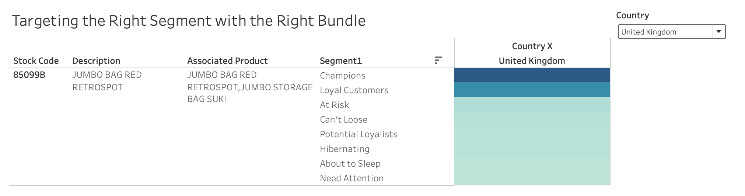
Notes:
This visualization demonstrates how we connected our Apriori-based product bundling insights to specific customer segments in the UK using RFM analysis.
Here, we focus on the product “JUMBO BAG RED RETROSPOT” with Stock Code 85099B. Apriori analysis identified that this product is frequently purchased with the “JUMBO STORAGE BAG SUKI.” So, these two items form a strong, data-driven bundle.
What we’re seeing in this chart is how different customer segments—such as Champions, Loyal Customers, and At Risk—responded to this bundle based on their actual sales behavior.
The darker shades represent higher sales volumes. As shown here, Champions and Loyal Customers in the UK are the most responsive to this bundle, making them ideal targets for promotional campaigns. Meanwhile, segments like Hibernating or About to Sleep show much lower engagement, which signals that these customers may not be influenced by bundling alone and might require reactivation strategies instead.
So, the key takeaway here is that bundling shouldn’t be one-size-fits-all. By mapping bundles to segment behavior, we ensure we’re targeting the right product combinations to the right customers, making our marketing smarter and more effective.

Slide 21
Our Recommendations
1. Champions & Loyal Customers: These are your top-value customers engaged, consistent buyers who respond well to exclusivity and early access. The goal is to retain loyalty and increase basket size.
Launch premium decorative bundles (e.g., T-light holders, patterned lunch bags) as exclusive early-access offers.
Time campaigns to hit seasonal peaks like October in the UK or early summer in Germany to maximize ROI.
Use targeted email campaigns and VIP-only landing pages to make them feel recognized and prioritized.
2. Potential Loyalists & Promising Customers: This group is on the verge of becoming loyal they need a small incentive or nudge. The goal is to convert them into repeat, high-value buyers.
Promote mid-range practical bundles (e.g., kitchen sets, snack boxes) with offers like “buy more, save more.”
Align campaigns with moderate-demand months like May–June or September to catch them before they churn.
Use retargeting ads, loyalty perks, and personalized newsletter offers to drive conversions and increase engagement.
Notes:
Now that we’ve analyzed our segments and identified bundling opportunities, let’s talk about targeted recommendations.
We start with Champions and Loyal Customers—our most valuable segments. These are customers who purchase frequently and recently, and while they’re already engaged, there’s still room to grow their basket size. We recommend launching exclusive premium bundles—for example, decorative items like t-light holders or patterned lunch bags—positioned as early-access or VIP-only offers. These should be timed around seasonal peaks like October for the UK or early summer for Germany, when demand historically rises. Using personalized email campaigns and VIP landing pages can reinforce that sense of exclusivity and strengthen retention.
Next, we have Potential Loyalists and Promising Customers. These are customers who are showing promising behavior but haven’t yet reached full loyalty. Here, a slight nudge in the form of mid-range bundle promotions—like snack boxes or kitchen sets—combined with offers such as “buy more, save more” could do the trick. The timing matters too—we suggest targeting them in shoulder months like May, June, or September when demand dips slightly. And finally, retargeting ads and loyalty perks like reward points or personalized newsletters can help deepen engagement and turn these customers into repeat, high-value buyers.

Slide 22
Our Recommendations
3. At Risk & About to Sleep Customers: These are customers slipping away. They’ve shown strong behavior in the past, so the goal is to re-engage them with relevance and urgency.
Offer bundles featuring their past favorite items, paired with a small free add-on to encourage re-trial.
Launch these offers 2–3 weeks ahead of seasonal peaks (e.g., early November in the UK) to catch their attention when purchase intent may return.
Use personalized, urgency-based messaging like “We miss you” via email, SMS, or account-based follow-up to prompt action.
Notes:
This final group includes At Risk and About to Sleep customers—these are buyers who used to engage with the brand but are now slipping away. They’ve shown potential in the past, so our focus here is to reignite interest and prompt a return.
To do that, we recommend offering bundles featuring products they’ve previously bought or browsed, ideally paired with a small incentive—like a free add-on or discount—to lower the barrier for re-engagement.
Timing is also crucial. These offers should be launched 2–3 weeks ahead of known seasonal peaks—for example, in early November in the UK—when purchase intent is more likely to resurface.
And finally, personalized outreach is key. Using urgency-driven messaging like “We miss you” via email, SMS, or even account manager follow-ups can create that emotional trigger to prompt them to take action.
In short, this segment requires a thoughtful mix of relevance, incentive, and timing to bring them back into the customer lifecycle.

